Slide 1
St Bees – Mirehouse
Cycle Track: The “Valley Link”
St Bees Parish Council
The future plan for cycling and footpaths in Whitehaven and surrounding area is now out for public consultation.
Click here to have your say. Closes 6th August.
Do you think the Valley Link is a good idea? If so, please say so in your reply.
Briefing document
Rev 7 21.07.2021

Slide 2
The original concept and study - 2000
Maps from the Whitehaven – St Bees cycle track feasibility report published in 2000; but not implemented.
St Bees level track down valley
Notional coastal route (addition by CCC)

Slide 3
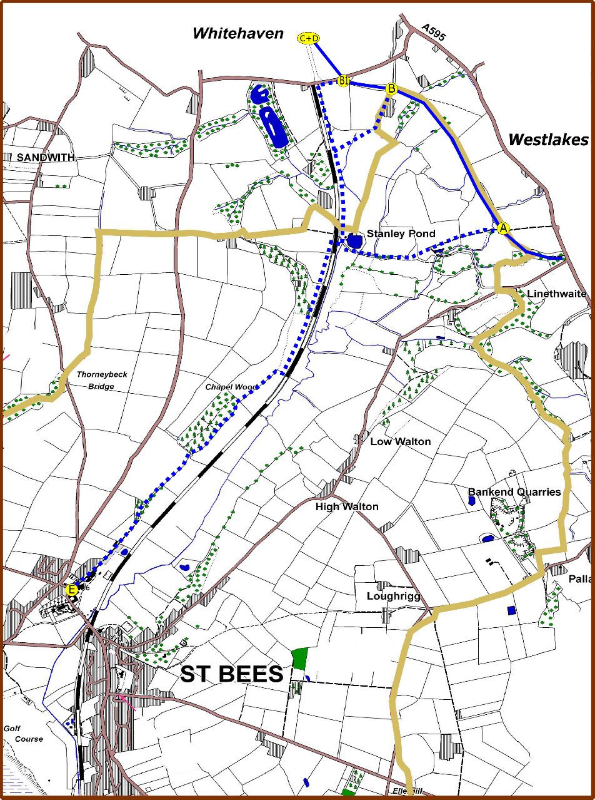
Route map – 2000 report
In 2016 St Bees Parish Council and Whitehaven Town Council contracted Sustrans to re-evaluate the 2000 plan.
The main options that are now being pursued are shown on the map
Preferred route South to North:
Start from B5345, Abbey Corner, St Bees.
Proceed along Wood Lane, skirting Abbey Wood to Coast to Coast underbridge and proceed via green route to Mirehouse Road
Possibility of other direct feeders onto existing cycle route 71/72
“X”
71/72
Key
Valley link route options
Existing national routes 71/72
St Bees parish boundary
Access points
A – direct to 71/71 direct for Westlakes
B - Join 71/72 at bridge 3
B1 – Mirehouse road then onto 71/72 at north bridge
C+D – joining 71/72 at access point A16
E – Wood lane St Bees
Approximately 60-70% of new route would be in St Bees parish and 30-40% in Whitehaven parish with access options B & B1.

Slide 4
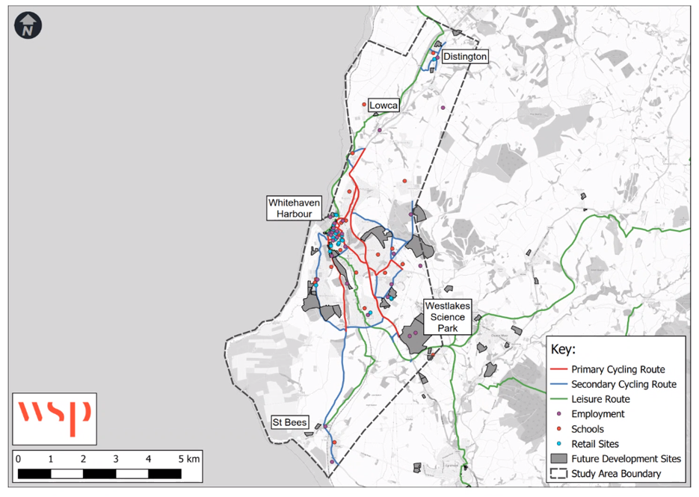
The Whitehaven LCWIP study area
LCWIP stands for “Local Cycling and Walking Infrastructure Plan”.
From Gov’t
“Local Cycling and Walking Infrastructure Plans ( LCWIPs), are a new, strategic approach to identifying cycling and walking improvements required at the local level.
They enable a long-term approach to developing local cycling and walking networks and form a vital part of the Government’s strategy to increase the number of trips made on foot or by cycle”
This is now out for public consultation. Click here to have your say. Closes 6th August.
Do you think the Valley links is a good idea? If so, please say so, and we will get it on the Plan.
Note - the detailed plans so far shown on consultation maps cover only Whitehaven, but we are assured by Cumbria County Council that coastal area Distington – St Bees is definitely included and ideas are welcomed.

Slide 5
Benefits of the “Valley Link”
Provide both cycling and walking off-road route from Whitehaven and Egremont/Cleator Moor/Frizington areas to St Bees, accessing coastal green spaces and St Bees beach
Route is family-friendly with easy grading and no road traffic.
Remove need to use existing dangerous narrow roads with long uphill sections and dangerous traffic conditions; particularly the B5345.
Provide a near-level sealed surface path suitable for motorised disabled scooter and wheelchair use
Provide a vital missing piece in the coastal cycleway jigsaw by providing a north-south near-level link avoiding the ascent via Egremont.
Suitable for:
  Cycle commuter use into Whitehaven and West Lakes from the south, and longer term, low level commuter access to Sellafield
  Leisure use cycling for families and enthusiasts
  Leisure walkers
  Disabled persons with mobility vehicles

Slide 6
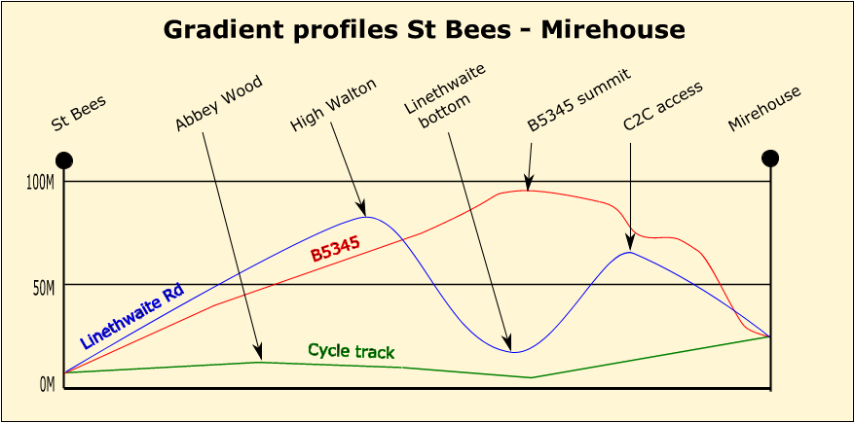
Coastal access - the roads problem
St Bees lies in a deep glacial valley, and from Whitehaven the roads follow ancient lines along the ridges or sides of the St Bees valley
Between Whitehaven and St Bees there are considerable hills to climb. The B5345 rises to 280 feet. The existing way to cycle route 71/72 via high Walton has a cumulative rise of 360 feet in two climbs. See gradient profiles.
Walking - There is only a convoluted footpath through the valley over boggy ground. There is no bridleway.
The railway took the obvious near-level route but the road routes have remained unchanged, and have become busier with denser and faster traffic. The proposed cycle track would follow the same levels as the railway.

Slide 7
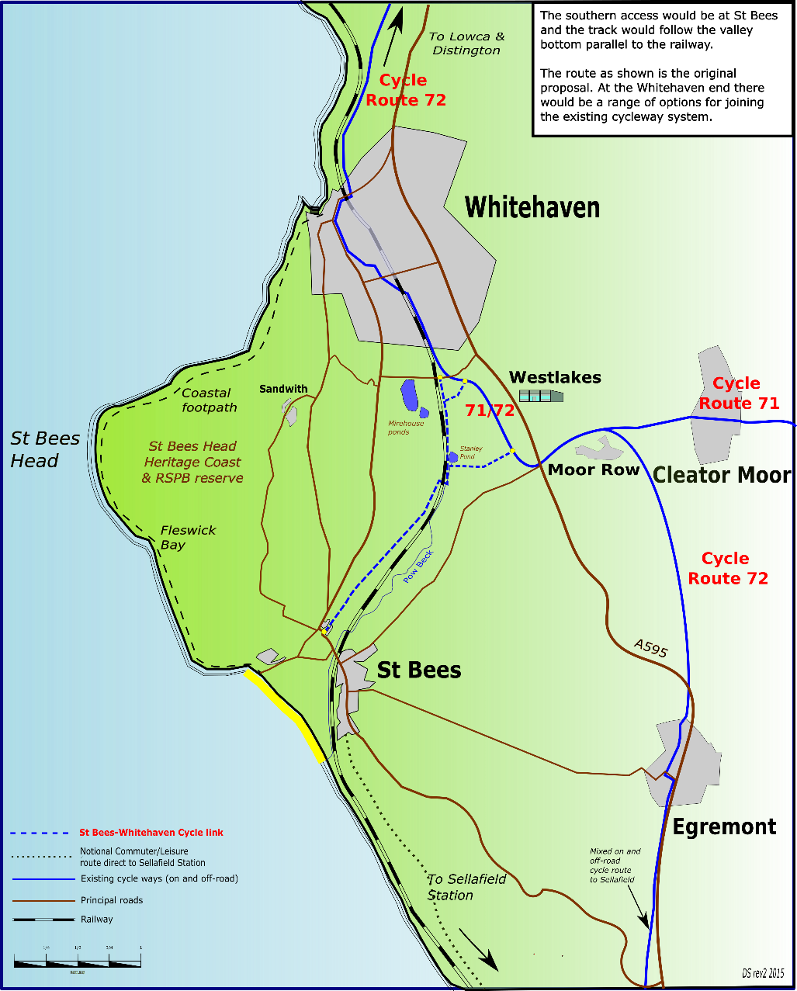
The local context – existing network
The St Bees-Mirehouse link would form a vital piece in an easy-graded true coastal route, away from the A595.
It would provide an easy-graded route from Egremont, Cleator Moor and Frizington areas to the coast.
It would connect National Cycle Routes 71 & 72 to the St Bees Heritage Coast.

Slide 8
Project history
2000 – Groundwork Trust produced a comprehensive feasibility report for Cumbria County Council/Copeland Borough Council. Stated that an off-road cycle route along the valley bottom was entirely feasible. May not have been implemented due to lack of funding.
2013-14 - St Bees Parish Council re-examines Groundwork’s 2000 report
2015 – Project re-launched with a local public exhibition. Huge local support. Partnership formed with Whitehaven Town Council to progress project
2016 – Revalidation study by Sustrans, funded by St Bees and Whitehaven local councils. Looked at ecology, environment, land ownership, buried services, drainage and various route options. Still found to be feasible
2016 – Land management at head of valley complicated by Nugen proposals for a large residential facility and West Cumbria Mining (WCM) coal loading facility. Both a challenge and an opportunity. Nugen plans are eventually shelved.
2021 – WCM planning still being debated and decided – but resolution one way or the other expected within this year
2021- onwards - hopes that the project gets on the LCWIP for Whitehaven Area, and can be helped by available LCWIP funding.
Don’t forget.
This is now out for public consultation. Click here to have your say.
Closes 6th August 2021.
We need to get the “Valley Link” in the future plans.

